Slide 1
Uncertainty
Science and scenarios
Abatement costs
Instruments for emission reduction
Impacts of climate change; valuation
Economic impacts; marginals; distribution
Impacts and development
Adaptation policy
Optimal climate policy
Discounting, uncertainty, equity

Slide 2
Optimal Climate Policy
International agreements
First-best climate policy
Ancillary benefits
Time discounting
Uncertainty
Equity

Slide 3
Optimal emission reduction
Climate change is long-term, global, uncertain problem
If you do not care about the distant future, far-away lands, remote probabilities, you do not care about climate change

Slide 4
Optimal Climate Policy
International agreements
First-best climate policy
Ancillary benefits
Time discounting
Uncertainty
Irreversibility and learning
Certainty equivalents and the Dismal Theorem
Equity

Slide 5


Uncertainty
Expected damage
$$ED=\sum_{s}{p_{s}D_{s}}$$
$$ED=\int{D\left(s\right)f\left(s\right)ds}$$

Slide 6
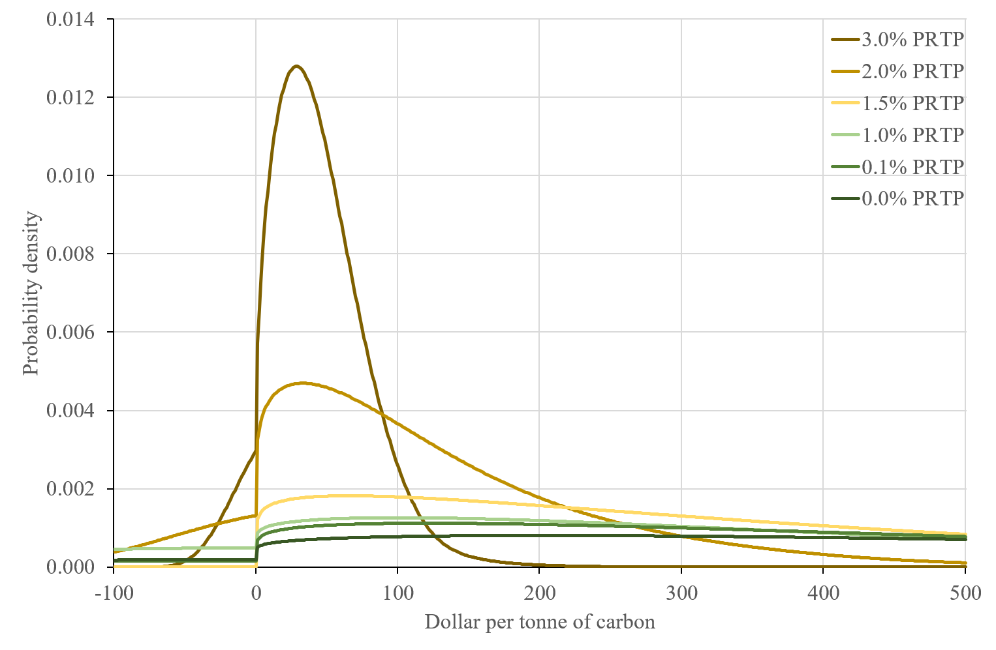

Slide 7
Social cost of carbon, $/tC
PRTP | Mode | Mean | SD
0% | 202 | 686 | 644
1% | 100 | 378 | 471
3% | 28 | 43 | 35
EU | 102 | Oct | 2020
California | 62 | Oct | 2020
Shenzen | 18 | Oct | 2020

Slide 8
Optimal Climate Policy
If everything is known with certainty
in a static problem, marginal costs should equal marginal benefits
in a dynamic problem, marginal net present costs should equal marginal net present benefits
If probability distributions are known
in a static problem, marginal expected costs should equal marginal expected benefits
in a dynamic problem
without either irreversibilities or learning, marginal expected net present costs should equal marginal expected net present benefits
with both irreversibilities and learning, things are different

Slide 9
Irreversibility
If current decisions have no implications for the future – that is, the consequences can be undone or reversed – the problem is not really dynamic
The problem is a series of static problems
Few economic problems are static or serially static
Capital is long lived
Carbon dioxide stays in the atmosphere for a long time
Current decisions depend on future decisions

Slide 10
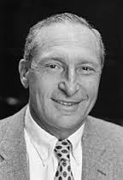
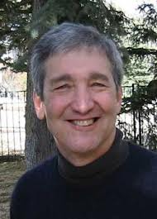
Learning
We do not know what the future will bring, we do not know what we will learn, but we do know that we will learn
That means that we will improve our decisions as we gather more information
In turn, we can relax a little today: Because future decisions are more accurate, we do not need to be so risk averse today

Slide 11
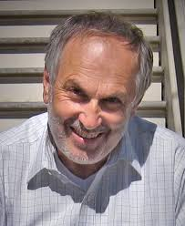

Slide 12
Optimal Climate Policy
International agreements
First-best climate policy
Ancillary benefits
Time discounting
Uncertainty
Irreversibility and learning
Certainty equivalents and the Dismal Theorem
Equity

Slide 13

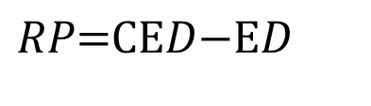
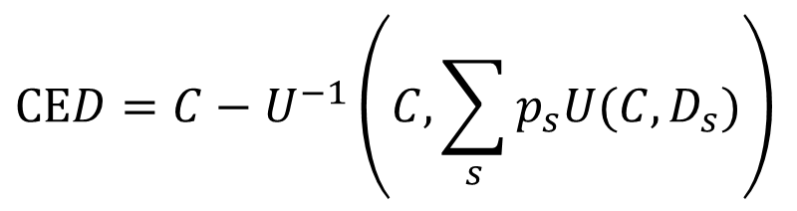
Uncertainty
Expected damage
Certainty equivalent damage
Risk premium
$$ED=\sum_{s}{p_{s}D_{s}}$$
$$\text{CE}D=C−U^{−1}\left(C,\sum_{s}{p_{s}U(C,D_{s})}\right)$$
$$RP\text{=}\text{CE}D\text{−}\text{E}D$$

Slide 16

Dismal Theorem
Weitzman (2009): the uncertainty about climate change may be too large for expected utility maximisation
If the growth rate of net consumption is uncertain, and we don’t know (but we do learn about) the standard deviation of the growth rate; then
Net present welfare goes to minus infinity.
Reason is that the chance of a disaster decreases polynomially while its impact increases exponentially

Slide 17
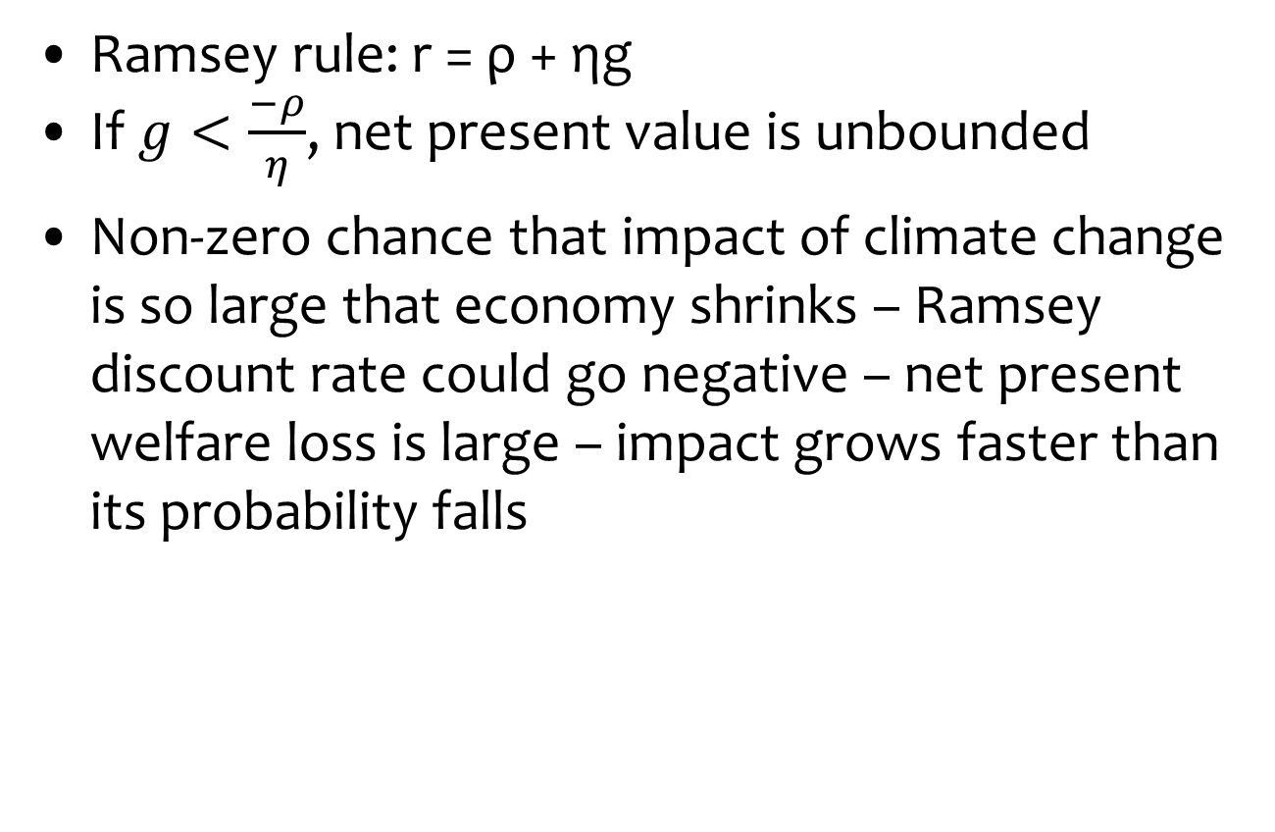
Dismal Theorem
Ramsey rule: r = ρ + ηg
If $g<\frac{−ρ}{η}$, net present value is unbounded
Non-zero chance that impact of climate change is so large that economy shrinks – Ramsey discount rate could go negative – net present welfare loss is large – impact grows faster than its probability falls

Slide 18
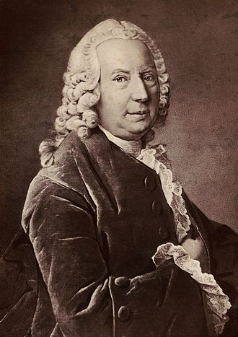
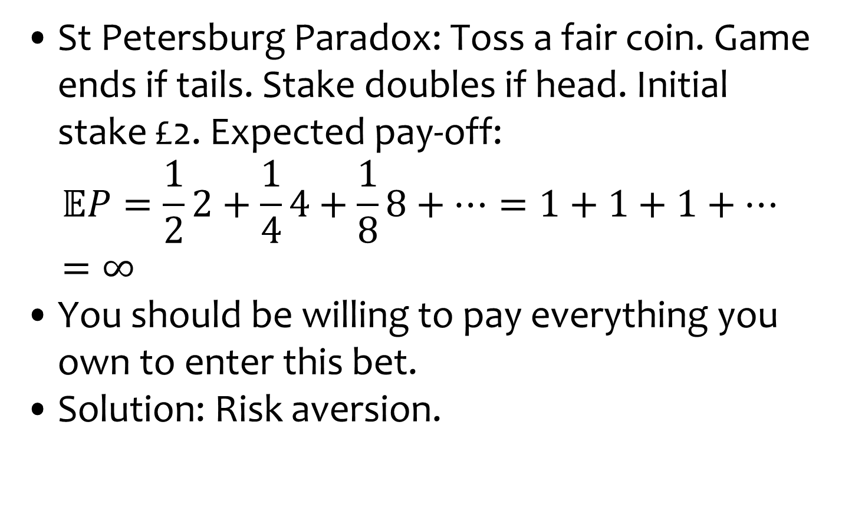
Dismal Theorem
St Petersburg Paradox: Toss a fair coin. Game ends if tails. Stake doubles if head. Initial stake £2. Expected pay-off:
$$𝔼P=\frac{1}{2}2+\frac{1}{4}4+\frac{1}{8}8+…=1+1+1+…=∞$$
You should be willing to pay everything you own to enter this bet.
Solution: Risk aversion.

Slide 19
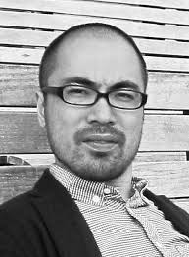
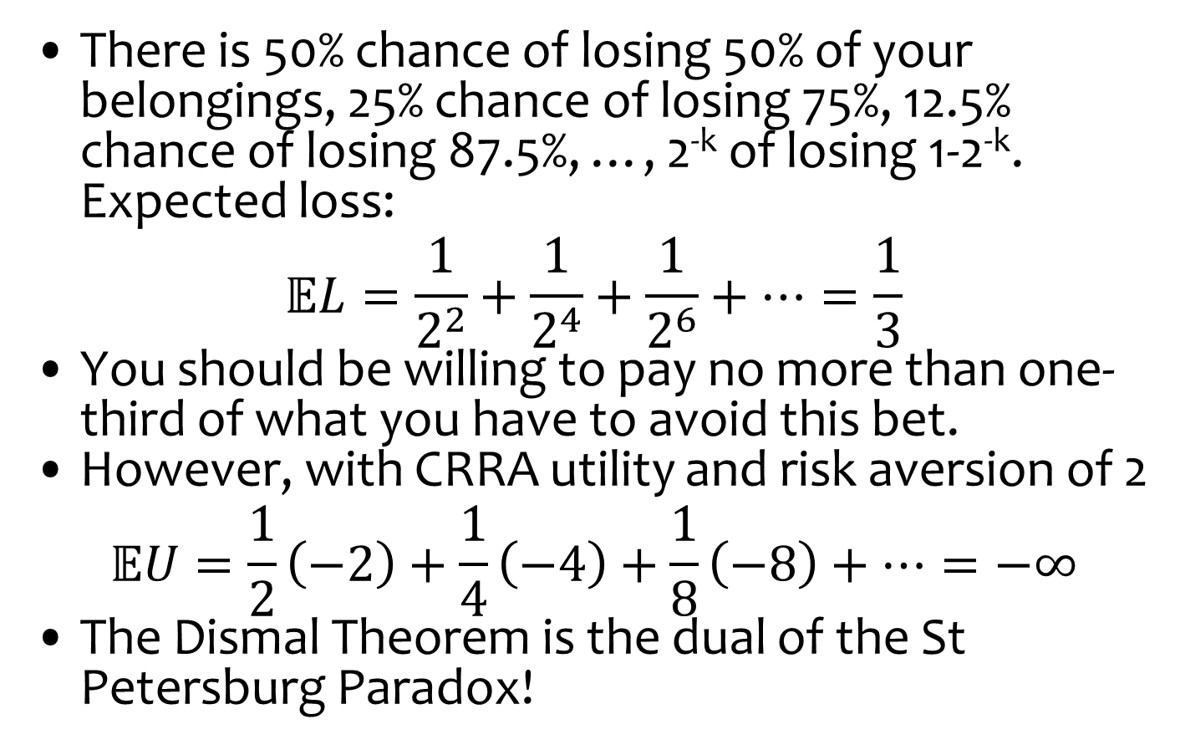
Dismal Theorem
There is 50% chance of losing 50% of your belongings, 25% chance of losing 75%, 12.5% chance of losing 87.5%, …, 2^{-k} of losing 1-2^{-k}. Expected loss:
$$𝔼L=\frac{1}{2^{2}}+\frac{1}{2^{4}}+\frac{1}{2^{6}}+…=\frac{1}{3}$$
You should be willing to pay no more than one-third of what you have to avoid this bet.
However, with CRRA utility and risk aversion of 2
$$𝔼U=\frac{1}{2}\left(−2\right)+\frac{1}{4}\left(−4\right)+\frac{1}{8}\left(−8\right)+…=−∞$$
The Dismal Theorem is the dual of the St Petersburg Paradox!

Slide 20
Dismal Theorem
Regardless of the derivation, the Dismal Theorem says that
Expected net present welfare is unbounded
The Pigou tax is arbitrarily large

Slide 21
Policy Implications
Some see the Dismal Theorem as a formalisation of the Precautionary Principle, others as a justification of stringent climate policy
That’s not true: The Dismal Theorem only says that you cannot use cost-benefit analysis in certain circumstances
Weitzman does not indicate what to do instead
Fossil fuels are an essential input in the short run, so an arbitrarily large carbon tax would do a lot of harm

Slide 22
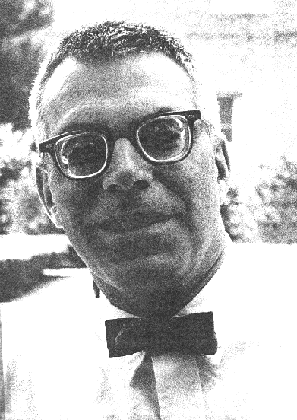
Minipercentile Regret
Minimax regret is a standard decision criterion in case of large uncertainty
For every state of the world, find the optimum tax
For every tax in each state of the world, calculate the welfare difference from the optimum
Across states of the world, find the tax that minimises regret
As continuous probability, we here use percentiles rather than the maximum

Slide 24
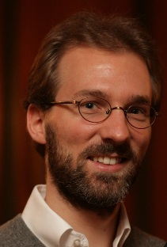
Alternatives
In minimax regret, you do the best you can in each state of the world, and make sure you are robust to uncertainty
There is no guarantee, however, that the outcome will be acceptable: Regret may be a small difference between very low levels of welfare
Regret is a measure of the slope of the welfare function, rather than its level
Therefore, minimize the fatness of the tail

Slide 26
p-value of the ADF test =
Probability of observing the data
under the null hypothesis of
non-stationarity / fat-tails

Slide 27
Implications
There is dangerous climate change
There is dangerous climate policy too
We characterise the Dismal Theorem in a Monte Carlo analysis of a numerical model
We use three alternative decision criteria, “Pigou with fat tails” tax should be between $50 and $170/tC
That’s a large range, but it is not an arbitrary number

